Slide 1

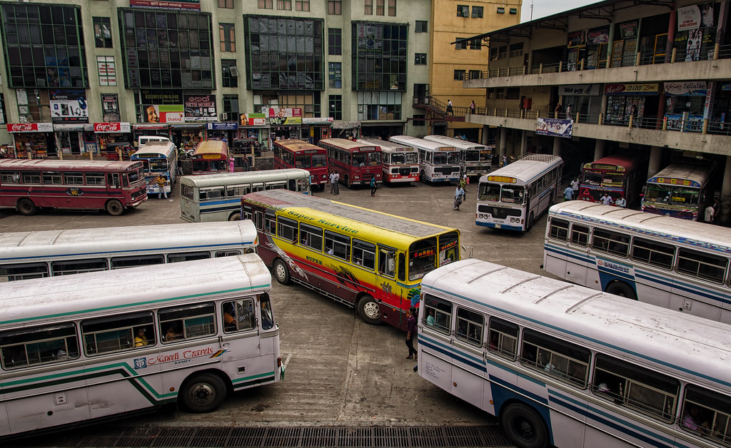
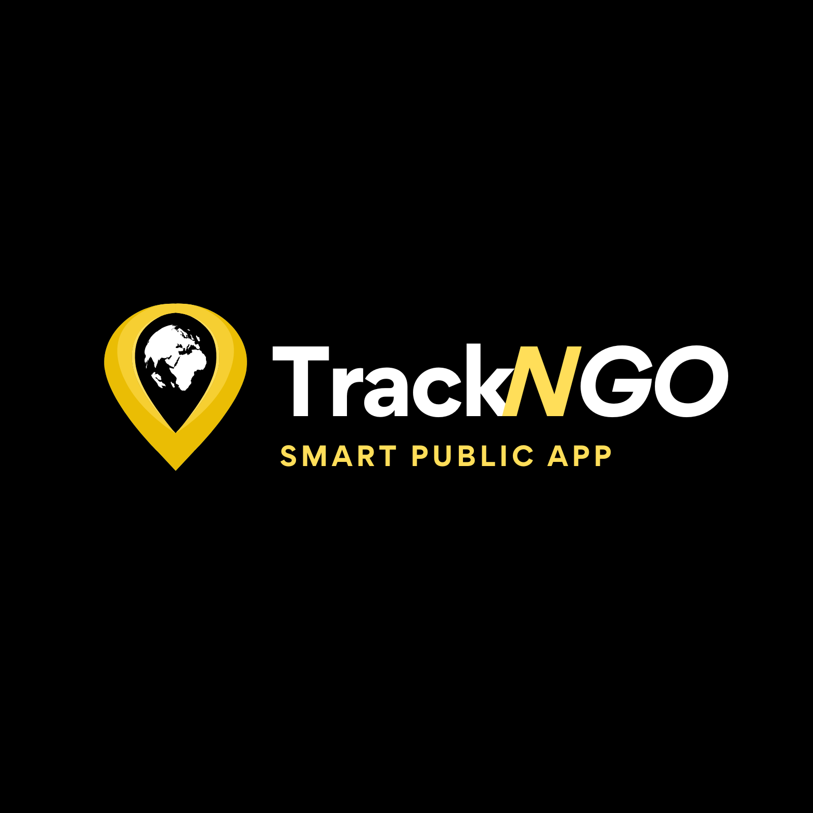
GROUP 08
SMART PUBLIC TRANSPORT APP
Notes:
Hello everyone, we are Group 08, and today, we’re excited to present our project, TrackNGo, a smart public transport app designed to improve commuting for the people of Sri Lanka.
I’m [Your Name], and along with my teammates [List team members], we’ve working hard in bringing this idea to life

Slide 2
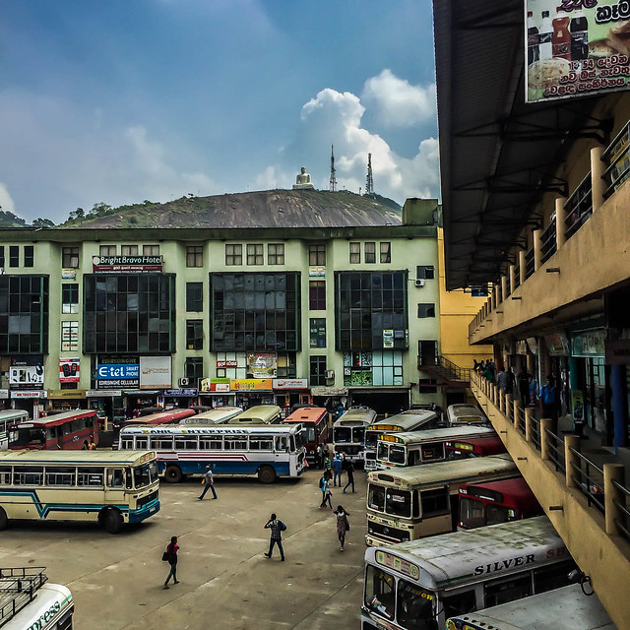

Introduction
Public transportation is vital for urban life, but Sri Lanka’s bus system struggles with long wait times, outdated schedules, and inefficient routes, frustrating commuters. The TrackNGo web app addresses these issues with GPS tracking and real-time route planning, allowing users to view live bus locations, plan routes, receive notifications, and report lost items enhancing the commuting experience.
Notes:
Let’s start by looking at why this app is important. Public transportation is essential for cities, but Sri Lanka’s bus system faces major issues.
Commuters often experience long wait times, deal with outdated schedules, and take inefficient routes. These issues make commuting stressful and unreliable

Slide 3
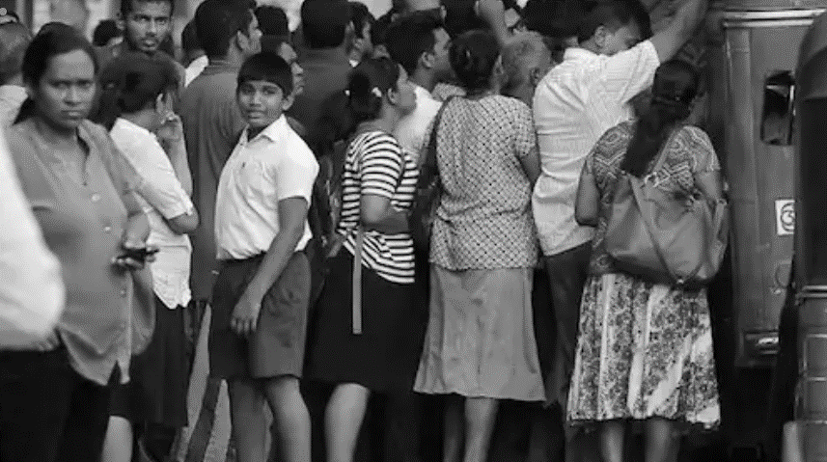
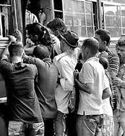
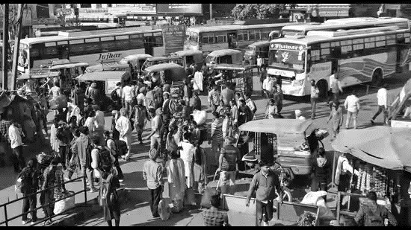
Problem Statement
Challenges in Sri Lanka's Bus System:
Extended wait times.
Outdated schedules.
Poor route optimization.
Issues: Lack of real-time updates and route planning.
Need: A tech-driven solution to enhance accessibility, efficiency, and reliability in public transport.
Notes:
We identified a few key challenges in Sri Lanka’s current bus system.
First, there’s extended waiting time at bus stops. Buses don’t always run on time, and delays are common.
Second, schedules aren’t updated frequently, leaving commuters with outdated information.
Third, routes are not well-optimized, which often leads to inefficient, time-consuming journeys.

Slide 4
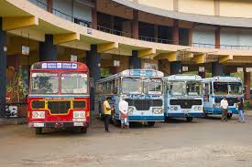
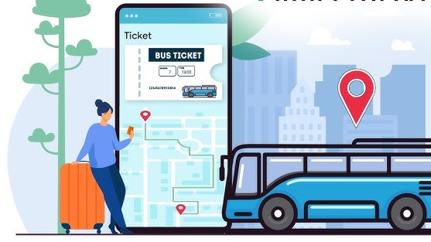
Project Objective
To develop a smart bus transportation app that improves commuting in Sri Lanka and Make public transit more accessible, reliable, and efficient, helping users plan journeys with ease.
Notes:
Our project objective is clear: we want to make commuting in Sri Lanka easier.
TrackNGo will improve the accessibility, reliability, and efficiency of public transport.
We believe that if people can see where their bus is, plan their route better, and receive real-time notifications, they’ll feel more in control of their journey, making the whole process much more convenient.

Slide 5
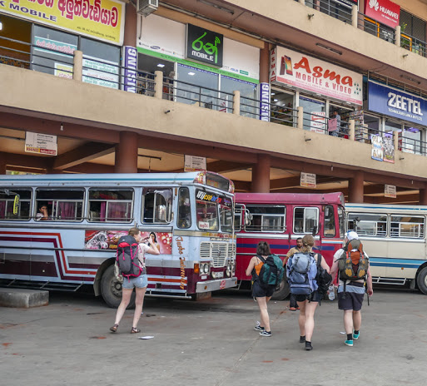

Proposed Solution
Real-Time Tracking: Live bus locations to reduce wait times.
Updated Schedules: Access the latest bus schedules anytime.
Notifications: Alerts for arrivals, delays, and disruptions.
Lost & Found: Report and track lost items easily.
Fare Calculation: Automatic fare estimates based on route.
News & Insights: Transport info plus relevant news updates.
Notes:
Here’s what TrackNGo offers:
Real-Time Tracking – Commuters can view live bus locations, reducing the time they spend waiting.
Updated Schedules – We provide access to the latest bus schedules.
Notifications – Alerts about arrival times, delays, or disruptions.
Lost & Found – A feature where users can report and track lost items.
Fare Calculation – Automatic estimates based on the chosen route.
News & Insights – Relevant transport updates and news

Slide 6

Non-Functional Requirement
Performance
Security
Scalability
Notes:
Besides functional requirements, non-functional requirements are also important.
These include performance, reliability, and user-friendliness.
For example, the app needs to load bus locations quickly and send notifications without delay.
We made sure TrackNGo has a clean, responsive design so users have a smooth experience

Slide 7

System Architecture
Frontend: React for creating an interactive and responsive UI.
Backend: Node with Express to manage API endpoints.
Database: MongoDB for storing bus routes, user data, and real-time tracking data.
Google Map API: For GPS Location Tracking System.
Notifications: HTML Notifications API
Notes:
Now, here’s how TrackNGo is built:
The Frontend is developed with React, making it responsive and user-friendly.
Backend is handled by Node and Express, allowing efficient API management.
Database is MongoDB, which stores bus routes, user data, and tracking data.
Google Maps API is integrated for live GPS tracking.
Notifications use the HTML Notifications API to ensure real-time updates.

Slide 8
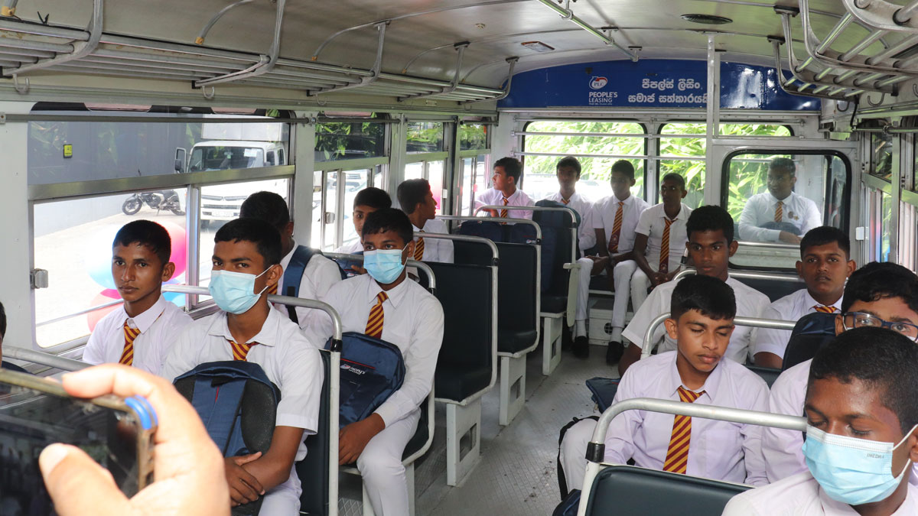

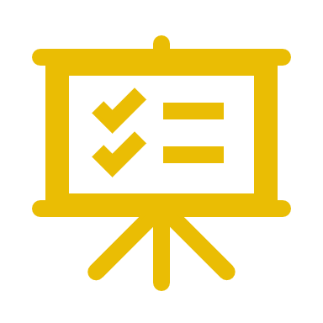
Conclusion
TrackNGo addresses key transit challenges with GPS tracking and real-time planning. By offering live bus locations, optimized routes, and timely notifications, it aims to improve commuter satisfaction and build a more efficient, reliable public transport system in Sri Lanka.
Notes:
In conclusion, TrackNGo tackles the key challenges in Sri Lanka’s public transport system through GPS tracking, real-time planning, and updated notifications.
We believe this app has the potential to significantly improve commuting experiences, offering a more reliable, efficient, and enjoyable way to travel."

Slide 9
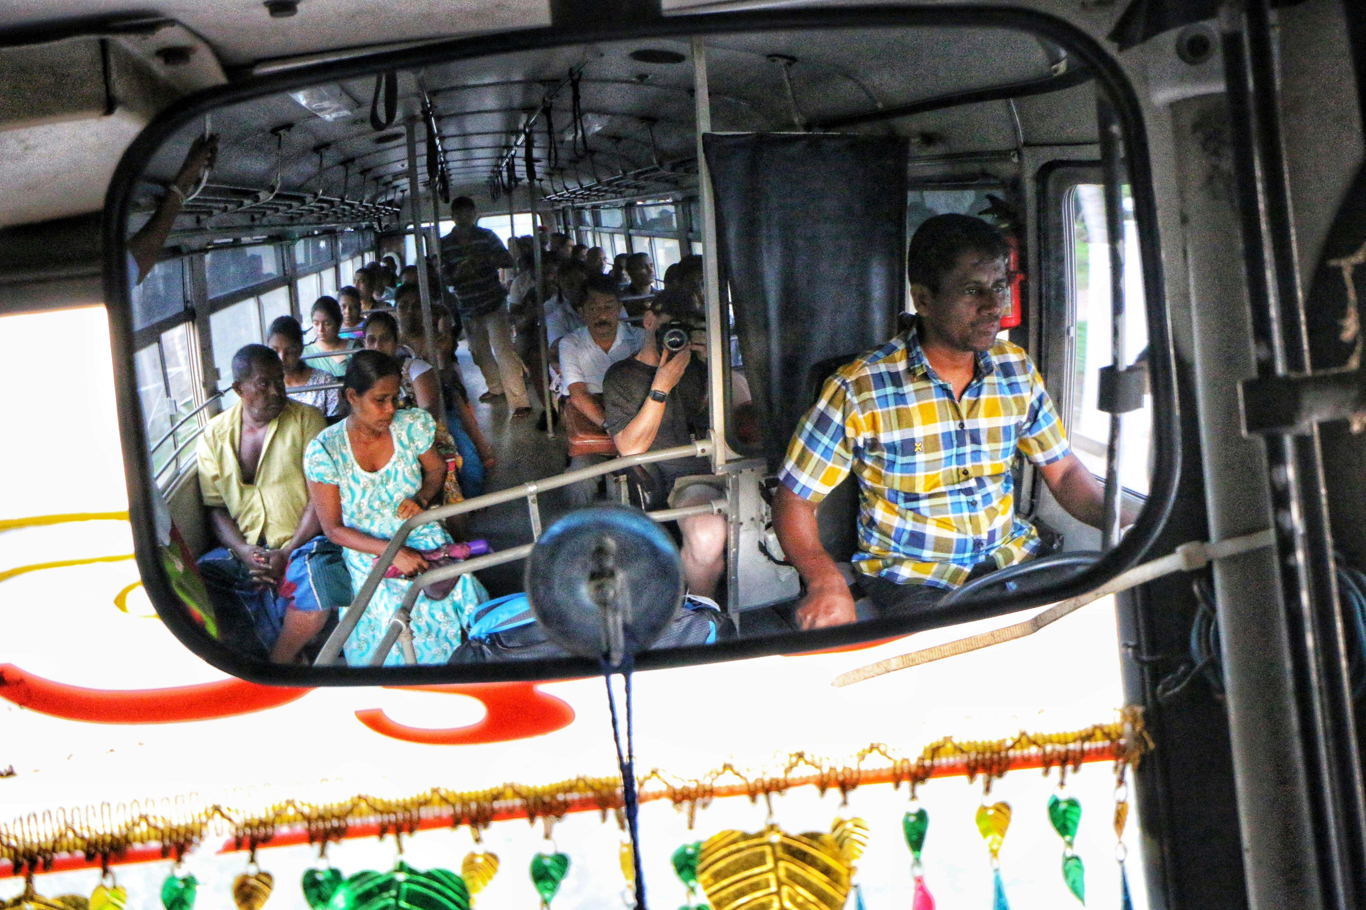
Group Details
2020/ICT/07 - Mr. Nalawansa U.K
2020/ICT/49 - Mr. Bandara R.M.M.T.
2020/ICT/32 - Mr. Kalhara K.A.T.
2020/ICT/23 - Mr. Naveen P.R.
2020/ICT/118 - Ms.M.T.F.Shazna
2020/ICT/36 - Ms. Dhanapala D.M.C.S.
2020/ICT/88 - Ms. Perera KNR
Notes:
Finally, here are the team members who contributed to TrackNGo’s development. Thank you for your attention, and we’re open to any questions."

Slide 10
Thank You
Notes:
Thank you once again for listening to our presentation. We hope TrackNGo can be a valuable asset to improve public transportation in Sri L
Thank you for your time and attention! We hope you enjoyed learning about TrackNGo, and we’re happy to answer any questions you might have."anka.

